Slide 1

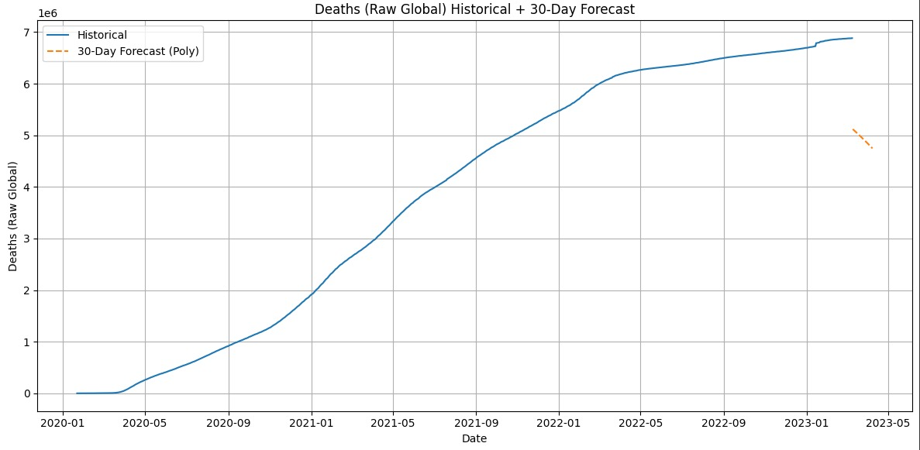
Forecasting COVID-19 Cases: A Time-Series Prediction Model
GROUP NO. - 02
GROUP MEMBERS
Manish Kumar(202401100300149)
Prateek Baliyan(202401100300177)
Mukesh Chauhan(202401100300158)
Prithvi Nawadiya(202401100300183)
Manav Mishra(202401100300148)

Slide 2

Introduction
This presentation outlines the methodology, analysis, and results of a time-series prediction model for forecasting future COVID-19 cases using historical data.
1.Pandemic Impact
Covid 19 challenged health sydtem worldwide dramatically
2.Forcast Importance
Accurate case prediction guide resource planning and response
3 . Our Project Goul is to use time series and regrssion to forecast future COVID 19 cases.

Slide 3

Problem Statement
1.Pediction Challenges – Infectious spread is dynamic and influenced by many factors
2.Model Limitation – Early forecast failed to capture variant impacts accurately
3.Modelling Needs and Resources for it – Robust , adaptive time series models improve forecast accuracy

Slide 4
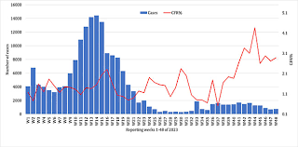
Current COVID-19 Situation
The ongoing COVID-19 pandemic has created an urgent need for accurate forecasting to help manage healthcare resources and implement effective public health measures. Currently, the dominant variant nationwide is LP.8.1, with 70% of cases, followed by XFC, with 9% of cases, and XEC, with 6% of cases. "The original omicron variant is gone now," says Dr. Rupp. "Currently subvariants of omicron are circulating, including MC.1.10.1, LB.1.3.1, and LF.7.“and at this the current moment there is a rapid rise in the number of cases .So ,taking all the steps and prevention is one of the important measures to overcome COVID 19 .

Slide 5

Methodology
The methodology followed in this project involves a structured approach, starting from data collection to model building and evaluation. The steps are as follows:
Data Collection: The user provides the dataset in the form of a CSV (Comma-Separated Values) file. This dataset contains historical COVID-19 case records with various relevant features.
2. Data Preprocessing: To ensure the data is clean and suitable for modeling, the following preprocessing steps are:
performed: Handling Missing Values: Missing data is treated using mean imputation for numerical features and mode imputation for categorical features.Encoding Categorical Variables: Categorical variables are converted into numerical format using one-hot encoding, which helps in applying machine learning models.Feature Scaling: All numerical features are standardized using StandardScaler to ensure uniformity in scale and improve model performance
3. Model Building: After preprocessing, the model is developed using the following steps: Data Splitting: The dataset is divided into training and testing sets to evaluate model performance effectively. Model Training: A Logistic Regression classifier is trained on the processed training data to learn patterns and relationships.

Slide 6

05
Results

Slide 7

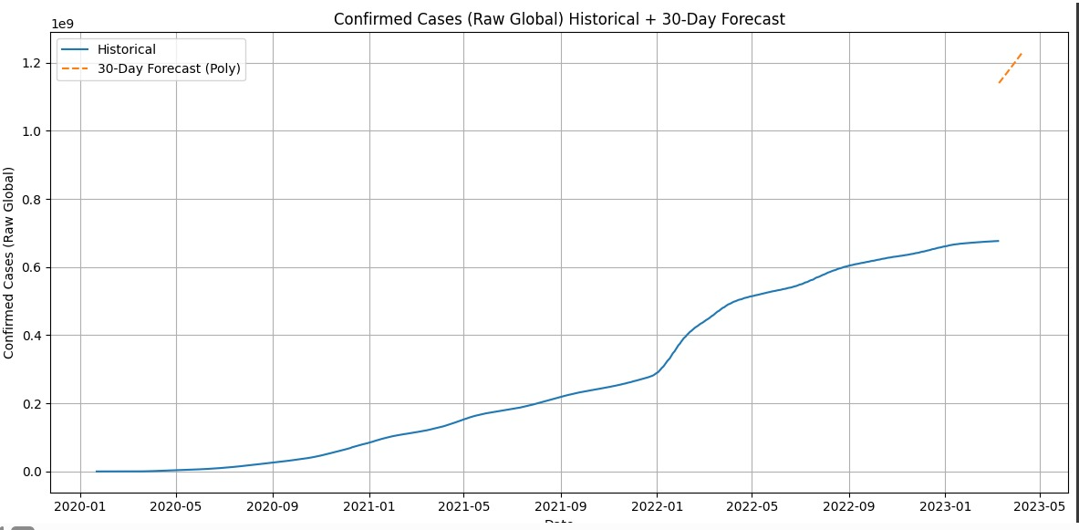
Performance Metrics
Performance metrics reveal the effectiveness of the model in predicting future cases. By analyzing these metrics, we can ascertain how well the model has adapted to the historical trends of COVID-19.

Slide 8
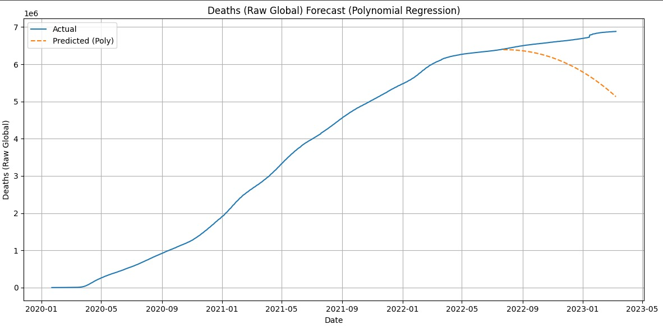
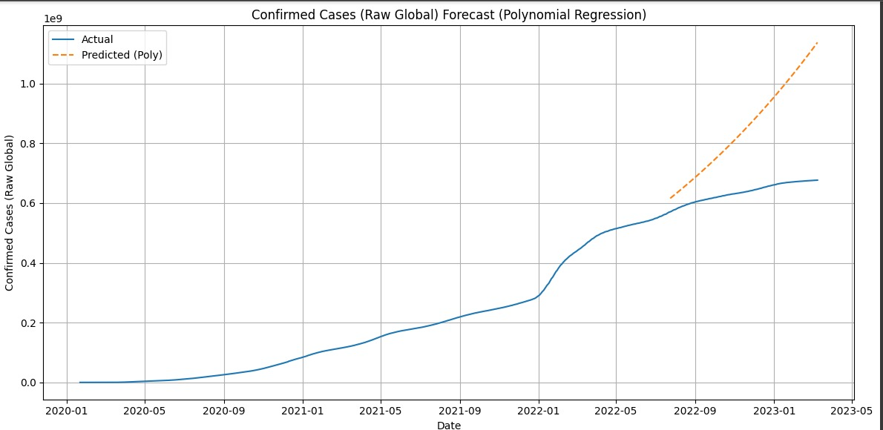

Slide 10
REFERENCES
Link: https://www.kaggle.com/datasets/antgoldbloom/covid19-data-from-john-hopkins-university
https://data.who.int/dashboards/covid19/cases
https://www.worldometers.info/coronavirus/

Slide 11
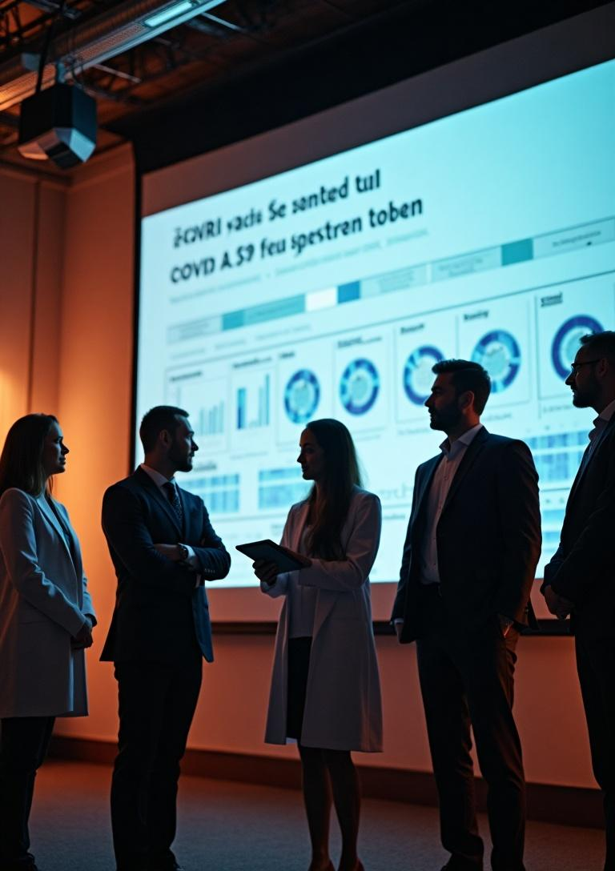
Conclusions
This presentation demonstrated the importance of a robust modeling approach for forecasting COVID-19 cases. Through careful data analysis, model selection, and evaluation, we can derive actionable insights that contribute to effective pandemic response strategies.

Slide 12
THANK YOU!

